Slide 1
Maturity Model for Microsoft 365 Practitioners
Introducing Practitioners for
Maturity Model
for Microsoft 365
April 2021
⭐Guest star⭐ Liam Cleary, Shareplicity | @helloitsliam
Emily Mancini, Sympraxis Consulting | @eemancini Marc Anderson, Sympraxis Consulting | @sympmarc
Simon Doy, iThink 365 | @simondoy
Simon Hudson, Novia Consulting | @simonjhudson
Initiative started by Sadie Van Buren as SharePoint Maturity Model in 2010
Notes:
EMILY

Slide 2

v
Agenda
Practitioner overview
Picture time with the Together Mode!
Introduction to the Maturity Model
Latest artifacts for the Maturity Model
Monthly Discussion: Security
How to get more involved
Notes:
EMILY

Slide 3

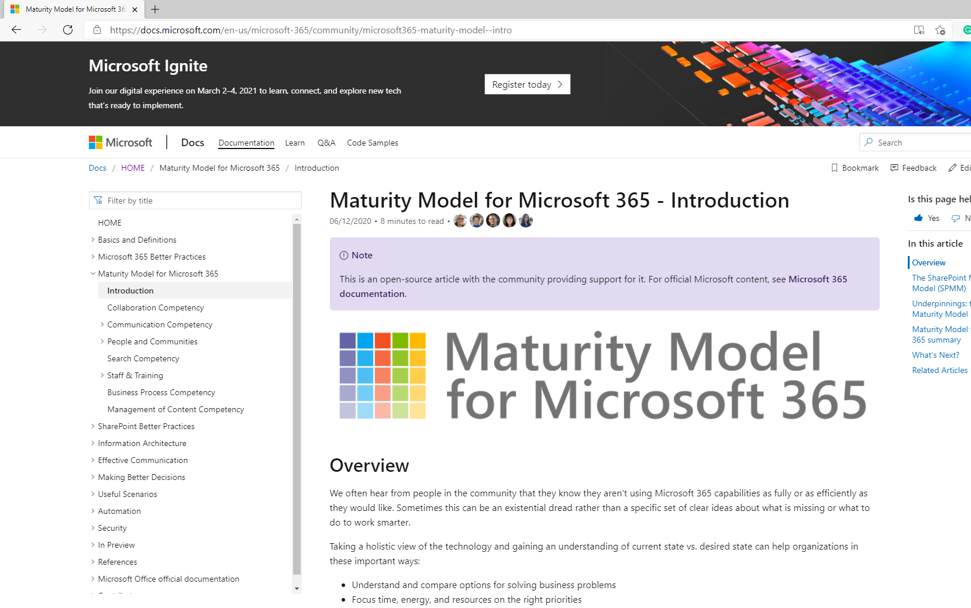
OVERVIEW
Practitioners for
Maturity Model
for Microsoft 365
https://aka.ms/sharing-is-caring
Notes:
EMILY (5 min)

Slide 4
OVERVIEW
Get involved in the
Maturity Model
for Microsoft 365
https://aka.ms/sharing-is-caring

Slide 5
Opportunities to participate in the community
Present case study (at MMM4M365 Practitioners or other speaking opportunities)
Contribute on GitHub
Provide feedback, insights, tools, and artifacts
Socialize
content

Slide 6
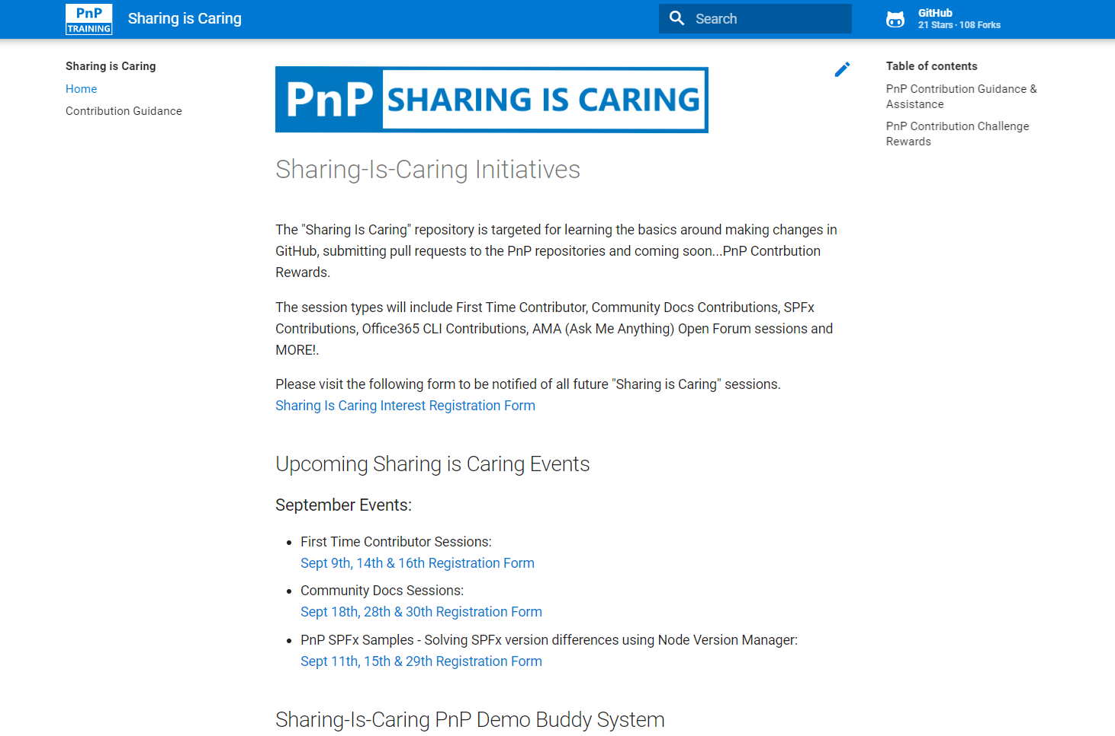

GUIDANCE
Want to get started on the open-source and community work?
Thank you, March attendees
First-Time Contributor Sessions
Tuesday, April 27th 2pm PST
Alexander Ernon
Andrew Burns
April Dunnam
Chris Massey
Christine Green
Daniel Westerdale
Divya Akula
Eloisa Marquez-Gonzalez
Harold Wolfinger
Hugo Bernier
Jason McMillan
Jon Flannagan
Kerry Lambert
Kunal Patil
Nanddeep Nachan
Nizar Grindi
Patrick Tucker
Pete Bostrom
Phil Broadbery
Rob Bell
Ron Jones
Seb Matthews
Ted Meyer
Vincent Georges
Community Docs Sessions
Thursday, April 22nd 9am PST
NEW SESSIONS: First Time Presenters Wednesday, April 21st 2pm PST
More than Code with VSCode Wednesday, April 28th 2pm PST
https://aka.ms/sharing-is-caring

Slide 7

Practitioners of MM4M365
Safe space to hone your pitch, test your thoughts, or decide how to promote your use of the Maturity Model
Discussion-based monthly meeting
Highlights of new assets
Understanding the competencies
Mapping technology to maturity levels and competencies
Running a workshop
Measuring maturity
Sharing anecdotes and success stories
Feedback on the maturity model
Notes:
EMILY

Slide 8
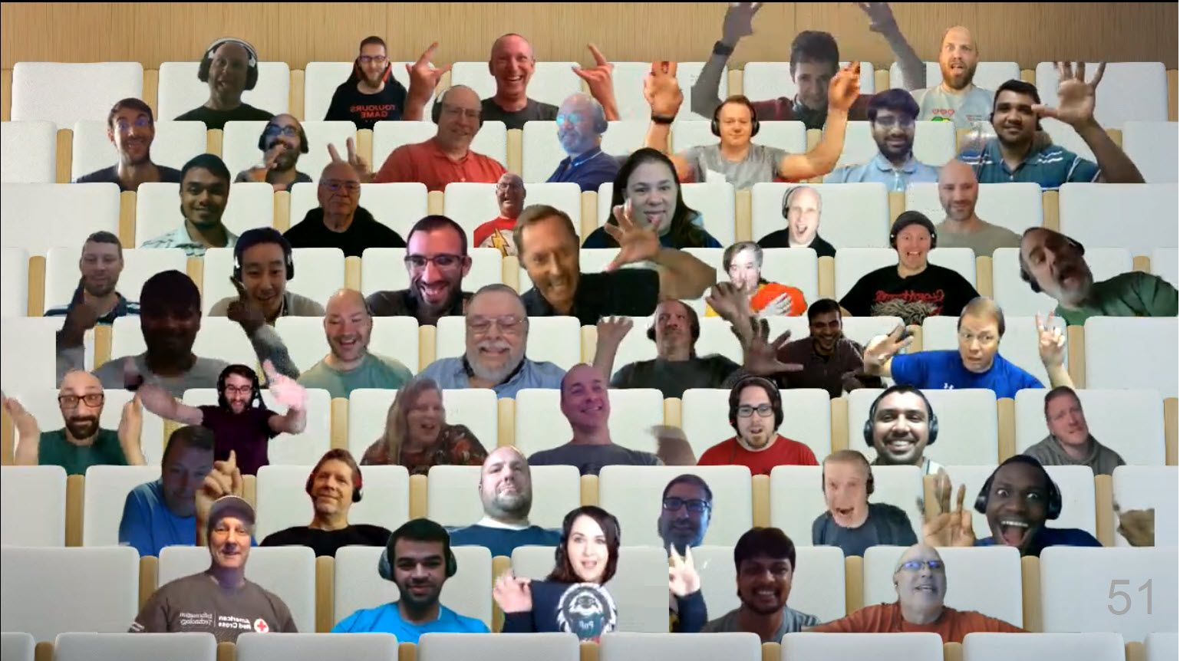

Optional picture time!
Video on and we’ll grab a Together Mode pic with those who are willing to do this.
We are together in this as a community!

Slide 9
INTRO
Maturity Model
for Microsoft 365
https://aka.ms/m365-community-docs
Notes:
EMILY (5 min)

Slide 10








MM4M365 aligns the company on what can and will be done across the platform
Improve organization through use of technology
Benchmark company and department
Select appropriate approach
Develop an organizational business and technical roadmap based on:
What's possible
What's desired
Organization's culture and drivers
Lead and support strategic planning, with senior management
Align implementation needs and objectives
Discuss use of the platform with IT – not just technology
Socialization tool
Notes:
-Improve organization: this technology is most successful when we are using it to solve existing challenges in the organization. Maybe you are struggling with raising transparency in decision making- this is a great opportunity for SP communication sites and news.
-Benchmark company and department: provides a rubric to measure the current state which will be critical in measuring growth and tracking ROI to share with stakeholders or decision makers. Collaboration and communication are softer topics so this develops the language to begin measuring it all. M365 is so much more than usage statistics because we are shifting the way people are working and communicating to solve these real-world problems
-Select appropriate approach - Not one size fits all. Your company size, culture, goals, and industry all have impacts of what is the right maturity level for your organization. A 6 person company may never need to be at the 500 level for Communication. This model does not dictate any levels as better than others but instead focuses on the impacts so you can choose which matter the most to support your objectives.
-Develop an organizational business and technical roadmap: Now that we know current state and identified future state, you can use the How To articles to navigate a plan to get there which enables you to lead and support strategic planning, with senior management.
-Align implementation needs and objectives- maybe you are at the beginning of your journey, your current state is Level 0 so you can choose which level you want to begin. Some organizations might need to begin at 300 for M365 to be impactful. Aligning on impact allows you to focus the tradition requirements conversation for M365 on the outcome objectives which is really about the change you are seeking in working better together.
-Discuss use of the platform with IT – not just technology: expanding IT’s understanding past the systems themselves to the outcome objectives it supports
-Socialization tool: Majority of your colleague using M365 aren’t IT professionals and don’t spend the amount of time we all do understanding the platform. The Maturity Model is a cliff’s notes version of what is possible. Useful artifact to share with your colleagues to increase their understanding of the platform. Even better- it is community maintained reducing your individual burden of creating these resources for the org!

Slide 11
MM4M365 has evolved with the platform
Published Competencies
Open Competencies
Supporting Articles
Business Process
In progress
Principles of…
Infrastructure
Collaboration
Search
Communication
To do
Communication
Management of Content
Security…
How to elevate…
People & Communities
Data & Analytics
Collaboration
Search
Communication
Staff & Training
People & Communities
Customization & Development
Staff & Training

Slide 12
MM4M365 provides benchmarks to measure your organization
Maturity Level | Description | Keywords
Level 500 Optimizing | Deliberate and systematic process improvement/optimization Focus is on continually improving process performance Addressing statistical common causes of process variation and iterative process improvement | Optimal, systematic, statistical, improvement-focus, automated, assured, proactive
Level 400 Predictable | Actively managed in accordance with agreed processes and has tracked metrics Effective achievement can be evidenced across a range of operational conditions Process has been tested and refined Process users demonstrate competence | Productive, interactive, responsive, enhanced, effective, adaptable, quality
Level 300 Defined | Defined and standardized Signed off, managed process Limited validation of effectiveness, doesn’t include edge cases Process users demonstrate familiarity | Documented, policy-driven, planned, controlled, stable
Level 200 Managed | Key processes defined but not standardized, uniformly or strongly applied Some ability to demonstrate consistent outcomes Limited buy-in from staff and management Widespread inconsistency and resistance | Routine, legacy, fire-fighting, variable, personally managed
Level 100 Initial | Default, starting/exploratory state People driven processes, lacking documentation and discipline Many ways of doing the same thing (with variable results) Characterised by inefficient legacy approaches and pockets of unmanaged innovation | Ad hoc, reactive, uncontrolled, chaotic, unstable, not designed
Source: https://docs.microsoft.com/en-us/microsoft-365/community/microsoft365-maturity-model--intro

Slide 13
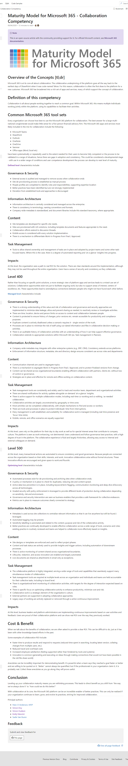
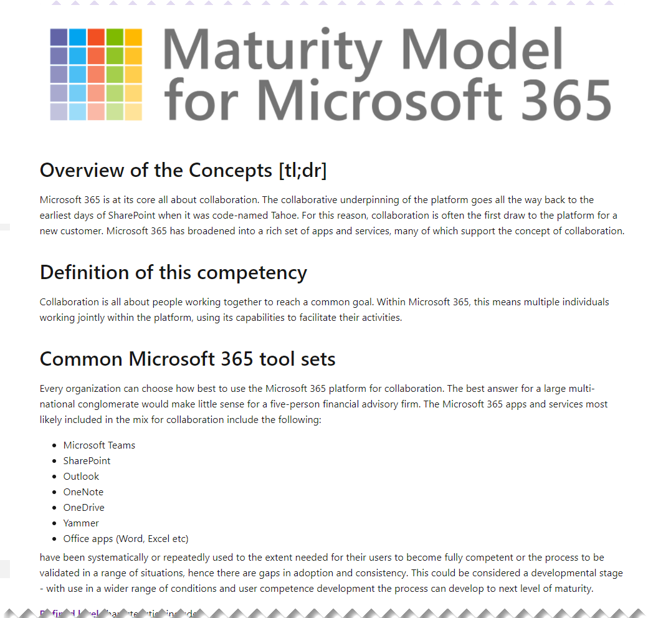
Source: https://docs.microsoft.com/en-us/microsoft-365/community/microsoft365-maturity-model--collaboration
Notes:
Some of the documents are pretty big; this is the collaboration one. However, we have tried to ensure they are consistent in flavour, structure and style, so that you can easily grab different competencies and jump straight in.

Slide 14
UPDATE
Latest artifacts for
Maturity Model
for Microsoft 365
https://aka.ms/m365-community-docs
Notes:
MARC

Slide 15
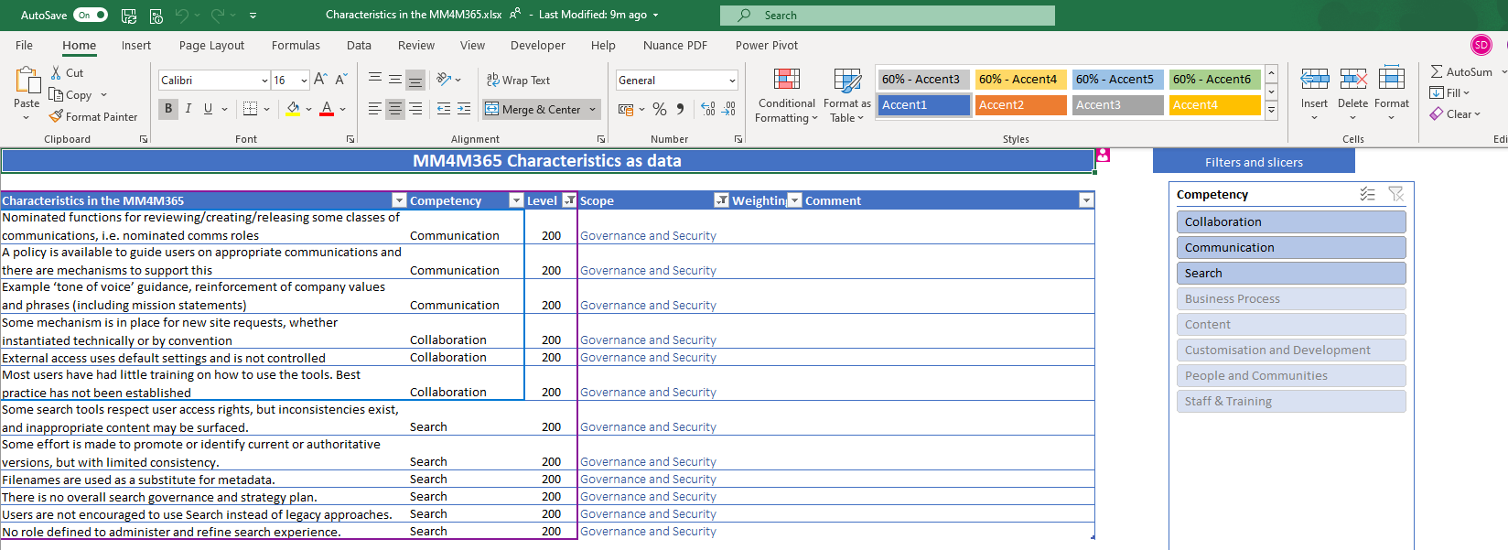
Latest additions to MM4M365
- Characteristics as Data
- How to elevate Collaboration:
Notes:
MARC

Slide 16
DISCUSSION
What is security in the Maturity Model?
https://aka.ms/m365-community-docs
Notes:
EMILY

Slide 17
Rules of engagement
Principles, not best practices
Characteristics, not processes
Not tied to specific Microsoft platform and features
Don’t forget non-technical aspects
Think broadly – not absolutes
And, of course: respect, inclusion, constructive challenge, decorum!
Notes:
SIMON

Slide 18

DISCUSSION
Share reactions while others are speaking
Come off mute and share your thoughts
Share your camera, we love virtually meeting you
Raise your hand if someone is speaking
Notes:
EMILY

Slide 19
DISCUSSION #1: What are the dimensions of security we need to consider?

Slide 20
What are the ‘dimensions’ of security we need to consider
Identity?
Control?
Monitoring?
Notes:
What are your biggest fears about security?

Slide 21
DISCUSSION #2: Review of security dimensions in the existing competencies

Slide 22
Security at the 100 level: Defining “Initial” Characteristics
Keywords: Ad hoc, reactive, uncontrolled, chaotic, unstable
Wild West – no specific security settings – defaults only
Current Characteristics in the MM4M365 | Competency
There are no restrictions or guidance on who should communicate to whom or by what means | Communication
High impact communications lack a review and approval process. | Communication
No formal process exists for requesting a new collaboration area (site, team, group). Naming convention, planned information structure, oversight etc. are absent. | Collaboration
End users are not trained enough to see utility in the platform. The dangers of information leakage are not understood. | Collaboration
The danger of search finding inappropriate content is not well understood. | Search
Search often does not respect user privileges and access rights. | Search
Notes:
Leading Questions
What does bad security look like?
What are 'barely' adequate organisations doing? What are Mom and Pop organisations like?
Phased deployment of controls

Slide 23
Security at the 200 level: Defining “Repeatable” Characteristics
Keywords: Repeatable, not enforced, processes documented
User setup is consistent = policies considered
Current Characteristics in the MM4M365 | Competency
Nominated functions for reviewing/creating/releasing some classes of communications, i.e. nominated comms roles | Communication
A policy is available to guide users on appropriate communications and there are mechanisms to support this | Communication
External access uses default settings and is not controlled | Collaboration
Most users have had little training on how to use the tools. Best practice has not been established. | Collaboration
Some search tools respect user access rights, but inconsistencies exist, and inappropriate content may be surfaced. | Search
Some effort is made to promote or identify current or authoritative versions, but with limited consistency. | Search
Users are not encouraged to use Search instead of legacy approaches. | Search
No role defined to administer and refine search experience. | Search
Notes:
Leading Questions

Slide 24
Security at the 300 level: Defining “Defined” Characteristics
Keywords: Managed, enforced, defined, competent
Current Characteristics in the MM4M365 | Competency
Communications policies are published and widely understood; some monitoring and reinforcement is in place. | Communication
Guidance exists on writing style; spelling and grammar checking is in active use. Feedback and corrections are acted on. Brand guidelines cover internal as well as external use. | Communication
External access is audited and managed to remove access when collaboration ends | Collaboration
Site de-provisioning process established as manual process | Collaboration
People profiles completed to identify roles and responsibilities | Collaboration
Best practice has been identified but not strongly implemented | Collaboration
Deviation from established tools and approaches is discouraged | Collaboration
User access rights are consistently applied, and processes exist to manage access. | Search
Notes:
What is 'Good enough'
What would you do if your organization was resource (time, money skill) constrained?

Slide 25
Security at the 400 level: Defining “Managed” Characteristics
Keywords: Measured, adoption, instrumentation
Current Characteristics in the MM4M365 | Competency
Message life cycle management ensures timeliness, approvals, moderation, accuracy, tracking and removal at the appropriate time. | Communication
There is strong understanding of the value and risk of collaboration and governance and security approaches are implemented to minimize data leakage, allow and prevent sharing as needed, to reactively review or investigate activities. | Collaboration
There are time, location, device and person limits on access to content and collaboration between people. | Collaboration
Content is protected to ensure history of changes, prior versions etc. remain accessible for productivity and compliance purposes. Duplicate content is actively disallowed unless a scenario requires it. | Collaboration
Processes are in place to minimize the risk of staff using out-dated information and files in collaborative decision making or activities | Collaboration
There is auditable history of collaboration activities | Collaboration
A role exists in the organization to manage enterprise search, to review keywords, feedback and search metrics with a view to ensuring effectiveness. | Search
Search is used to identify records and other artifacts that should be tagged. | Search
Search is be used to assist compliance processes such as subject access request and, legal eDiscovery. | Search

Slide 26
Security at the 500 level: Defining “Optimizing” Characteristics
Keywords: Optimization, automation, innovation
Current Characteristics in the MM4M365 | Competency
Lifecycle management is strongly implemented and largely automated. Compliance and DLP rules are comprehensively applied and enforced. | Communication
Automated processes exist for de-provisioning and archiving sites when collaboration ends. | Collaboration
Active data loss prevention is in place, including keyword/term flagging, communication monitoring and deep dive eDiscovery across all technologies | Collaboration
Graded security with policy enforcement is leveraged to provide different levels of protection during collaboration depending on sensitivity, risk and environment | Collaboration
Governance and security intervention are seen as business enablers that provides a safe framework for collective endeavors | Collaboration
Search is actively used to identify potential threats to information governance, security and legal obligations. | Search
Automated tagging and other metadata are in use | Search
Context (staff profiles, locations etc.) is integrated with source processes such as Joiners-Leavers, in order to maintain high quality of data | Search
Notes:
Leading Questions
What would amazing security look like?

Slide 27
DISCUSSION #3:
How do we address the human dimensions?
What are the mistakes 'users' make that we need to mitigate?
Does this allow the needs of security to be balanced against the needs of the wider business?

Slide 28
DISCUSSION #4:
What would you like to focus on in the May call?
Notes:
EMILY

Slide 29
DISCUSSION #5:
Are there any barriers to being involved in the Maturity Model we can help remove?
Notes:
MARC

Slide 30
Thank you
Follow us on Twitter
@M365Maturity | @M365CommDocs
Take the Maturity Model Self-Assessment
https://symp.info/MM4M365-SelfAssessment
Fill out the Maturity Model Survey
https://symp.info/MM4M365Survey
Discussions in Github
https://symp.info/MM4M365Discussion
Next MM4M365 monthly call: May 18th at 7:00am PST
Third Tuesday of every month
https://aka.ms/sharing-is-caring

Slide 31


aka.ms/m365pnp

Slide 32
Capability Maturity Model (CMM) provides benchmarks to measure your organization
Level 500
Optimizing
Focus on process improvement
Level 400
Quantitatively Managed
Processes are measured and controlled
Level 300
Defined
Processes documented for the organization and is proactive
Level 200
Managed
Processes documented for projects and often reactive
Level 100
Initial
Processes unpredictable, undocumented, poorly controlled and reactive
Source: https://en.wikipedia.org/wiki/Capability_Maturity_Model_Integration
Notes:
The MM4M365 is based on the Capability Maturity Model which was created in 1986.
The CMM was designed to help organizations build better software and is founded in software development process and has 5 levels running from Level 1 to Level 5, the Holy Grail (and often as elusive!).
Level 1 - Initial
The model starts at Level 1 which is the intro level, where things are chaotic and processes are not documented, poorly controlled and react to the environment that they exist within.
Level 2 - Managed
Managed is where things start to improve and some effort is made to document the processes. However, the processes are not enforced and vary from one area of the business to another. The processes are still not well thought out and are often reacting to their environment.
Level 3 – Defined This really takes us up a notch and processes are documented and now enforced so that they are consistent across the organization. More thought has been put into them and they are proactive.
Level 4 – Quantitatively Managed
This level takes those documented processes which are being consistently applied across the business and adds measures to them so that we can see how effective they are. Its interesting to see how these principles are so similar to agile approaches.
Level 5 – Optimizing
As I mentioned this is the holy grail now that we have measured processes in place we can start to tweak the process and see how that affects their performance. We can experiment and choose the tweaks which provide improvement.

